Slide 1
MGS 723: Geodynamics
Class 22: Fluid Mechanics V
(basic subduction calculations)
Main reference for today: Turcotte and Schubert

Slide 2
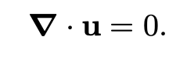

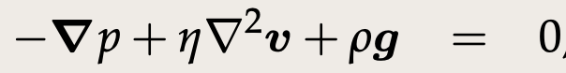
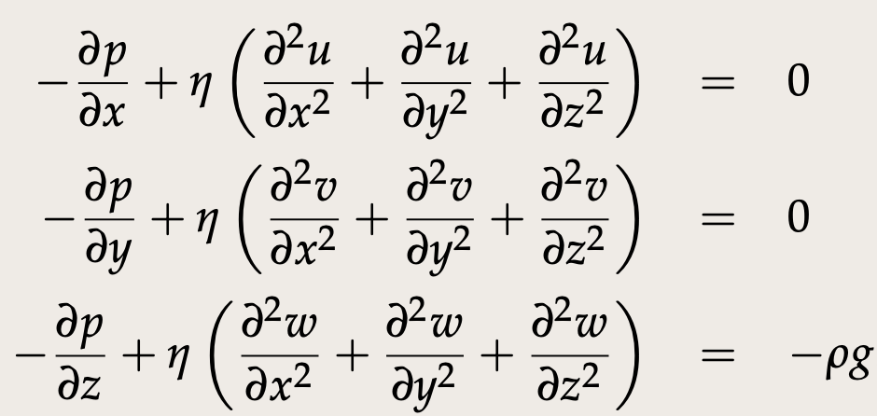
Recap: Stokes flow
Conservation
of mass
Conservation
of momentum
Vector form:
In full (Cartesian):

Slide 3
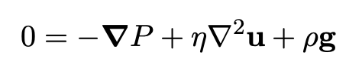
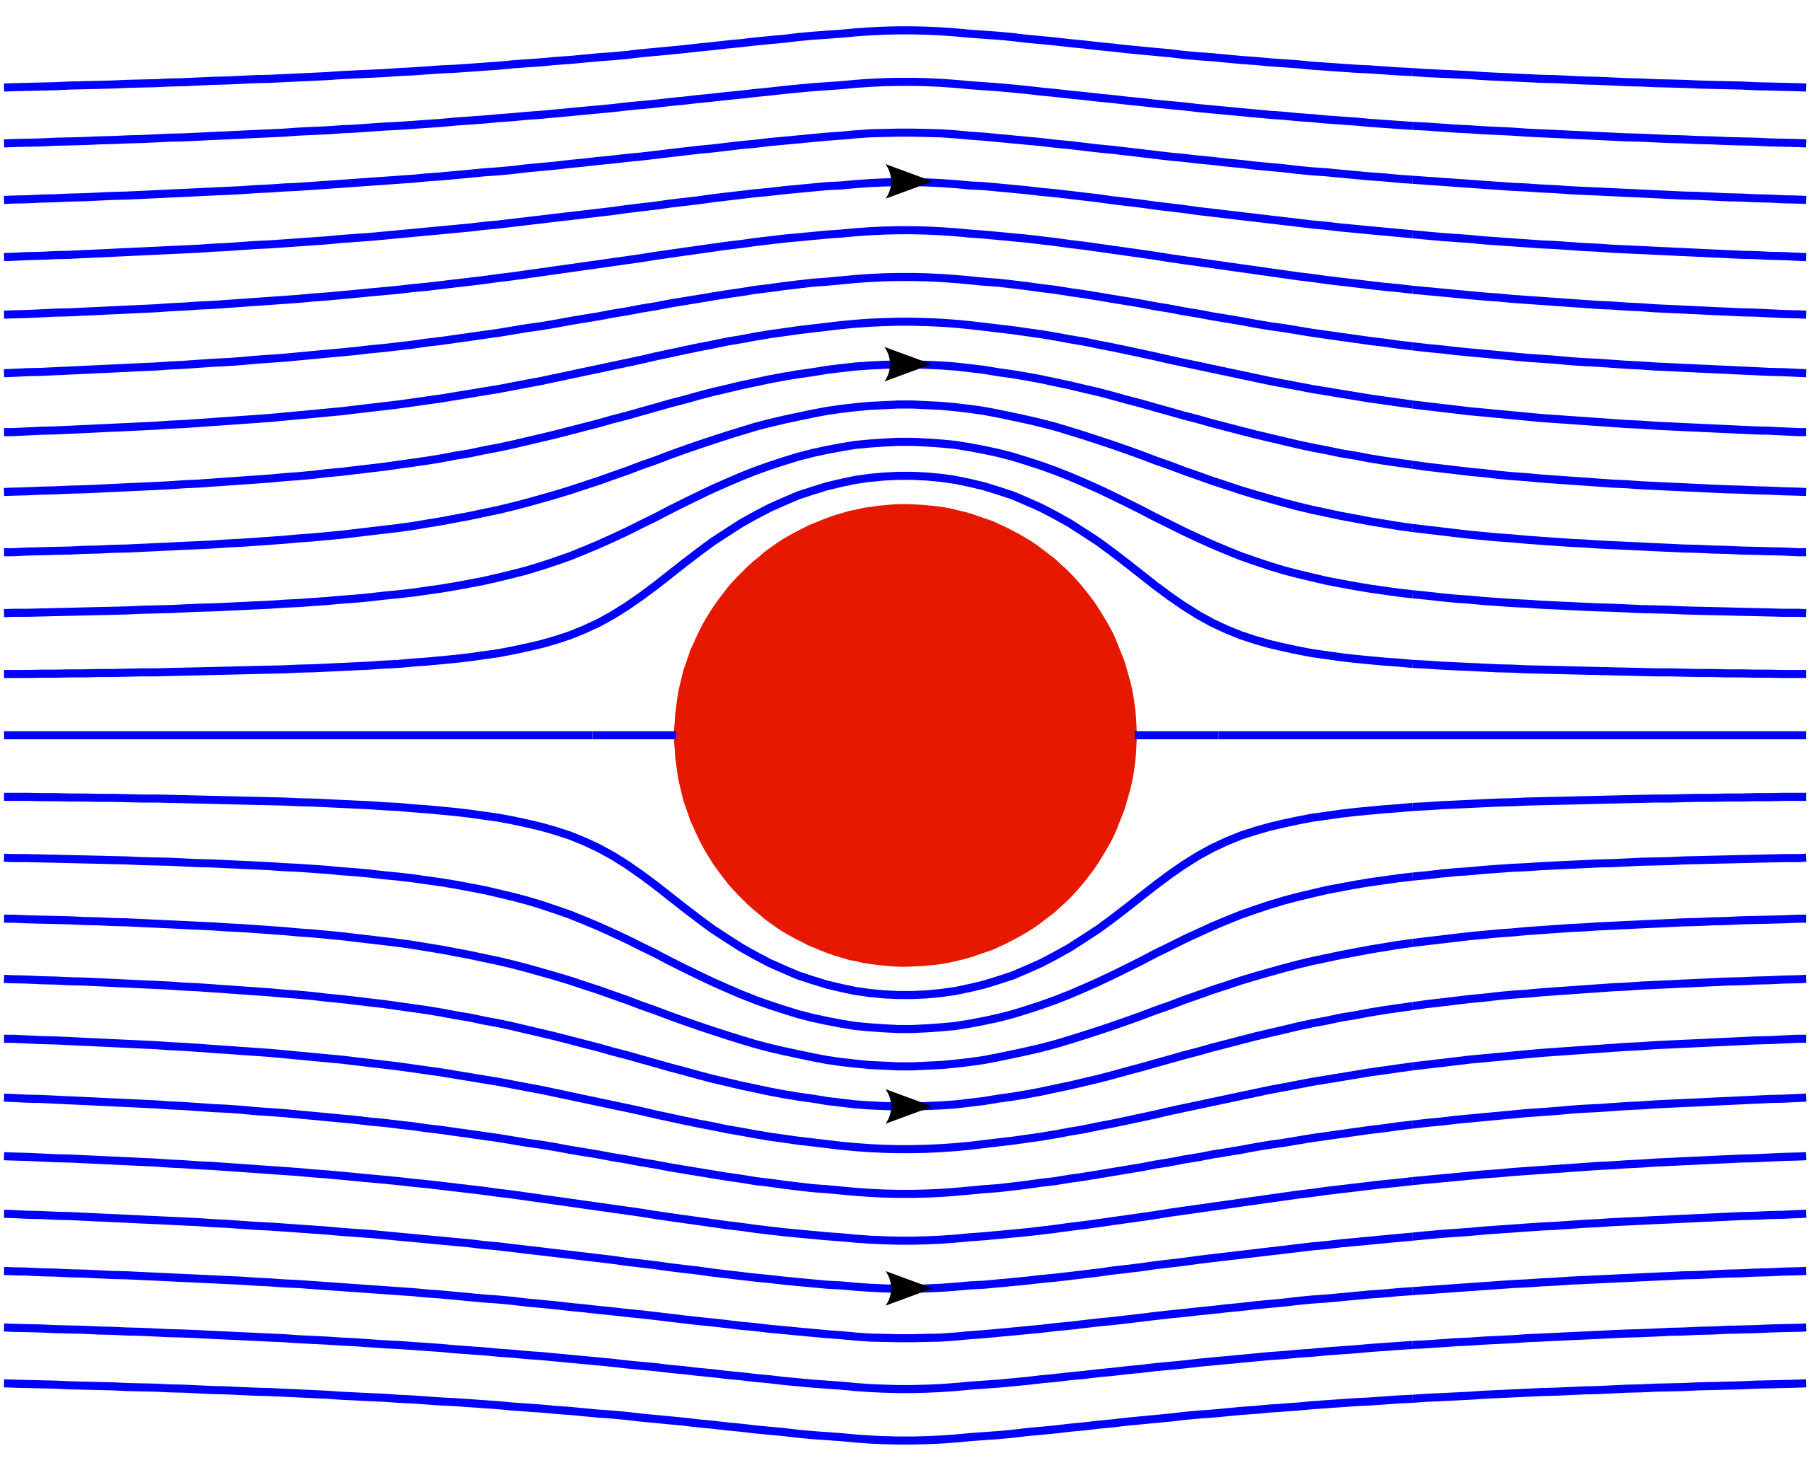
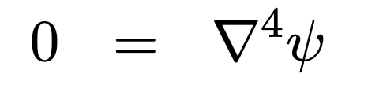
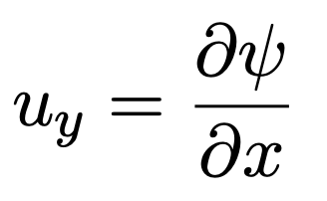
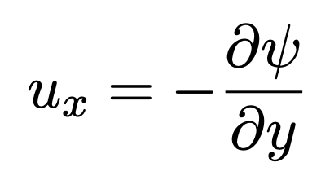
Recap: The stream function
A convenient way to re-cast the incompressible Stokes equation in 2-D:
Where:

Slide 4
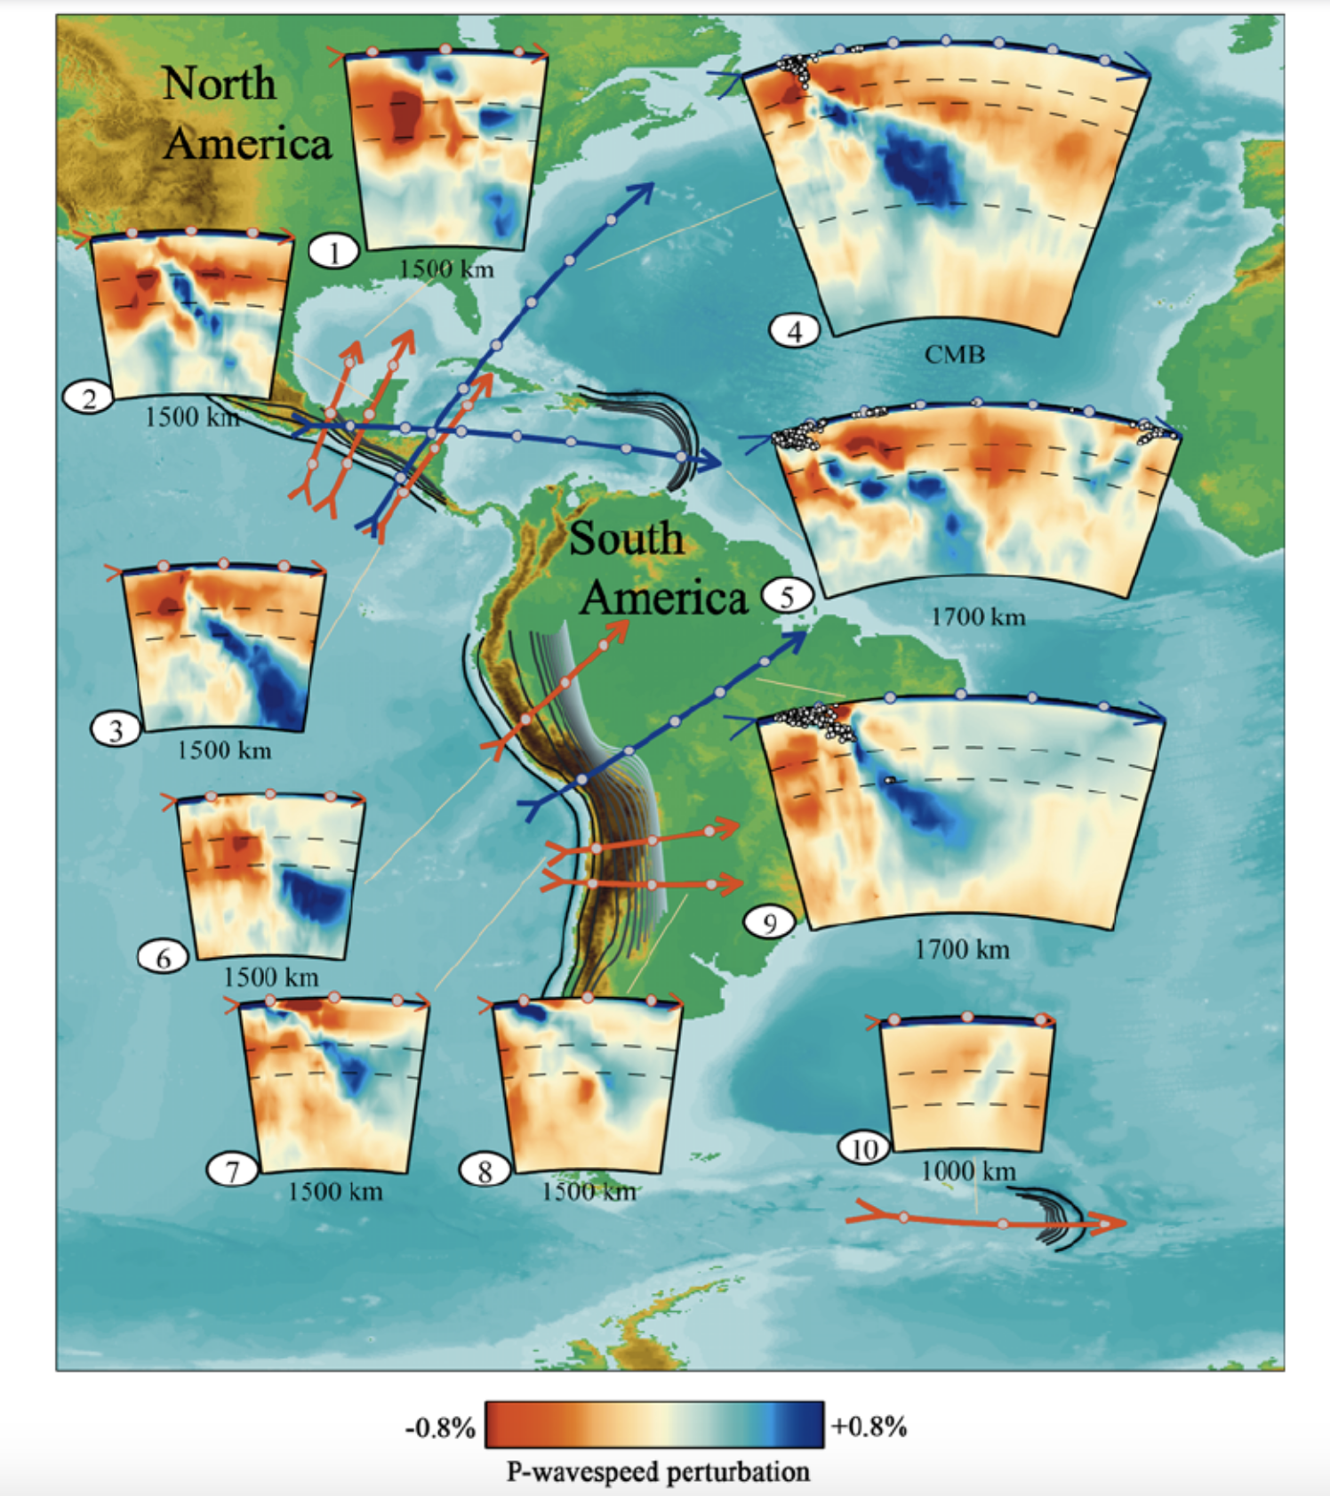
Why do slabs dip at $<$90$°$?
Li et al., 2008, G-cubed

Slide 5
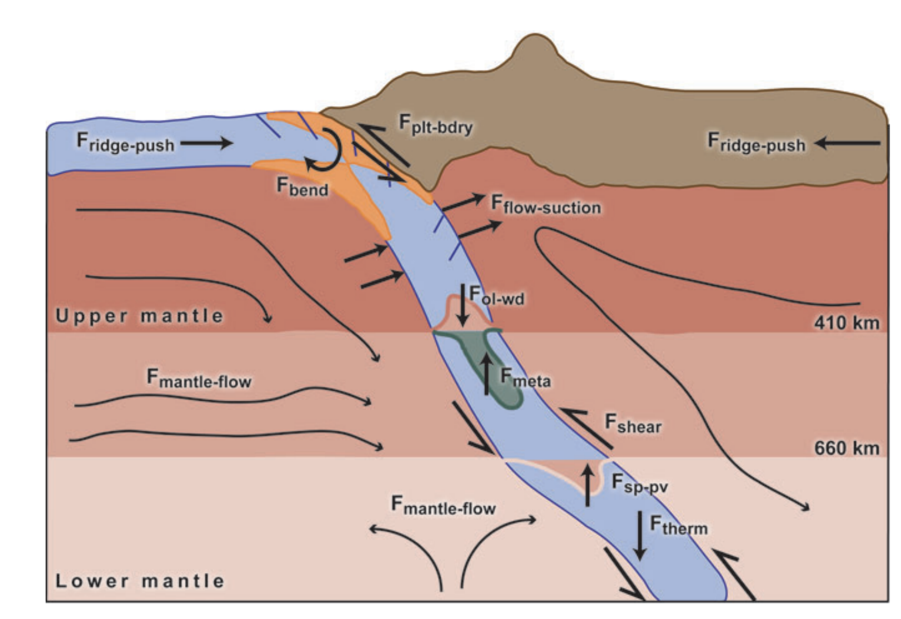
The forces acting on slabs
Billen, 2008, Annual Reviews

Slide 6
The forces acting on slabs
Billen, 2008, Annual Reviews

Slide 7
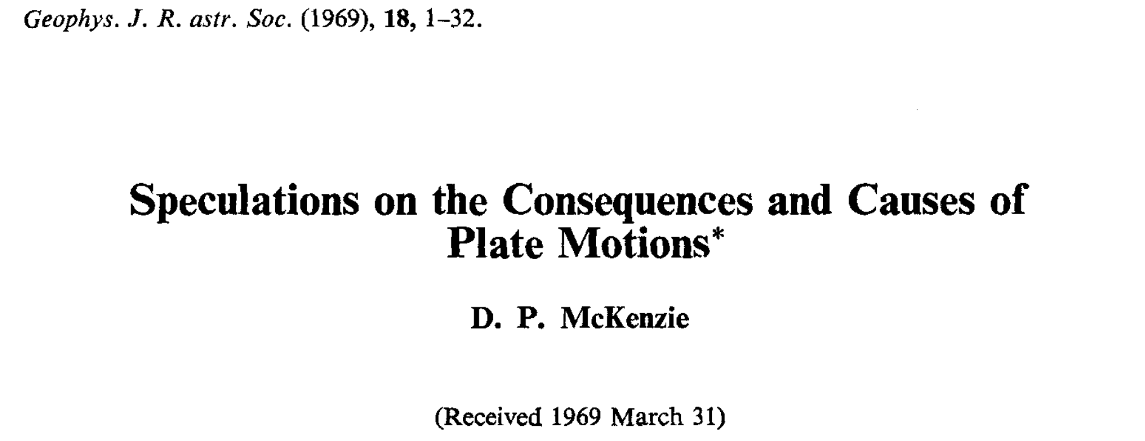
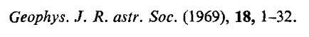
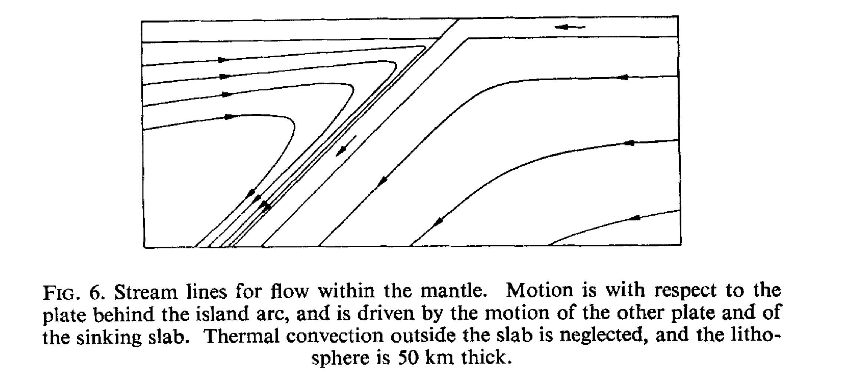
Flow in the mantle wedge
“corner flow”
McKenzie, 1969

Slide 8
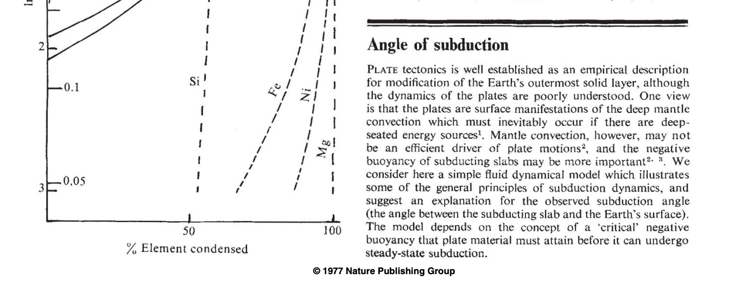
Flow in the mantle wedge
“corner flow”
McKenzie, 1969
Stevenson and Turner, 1977

Slide 9
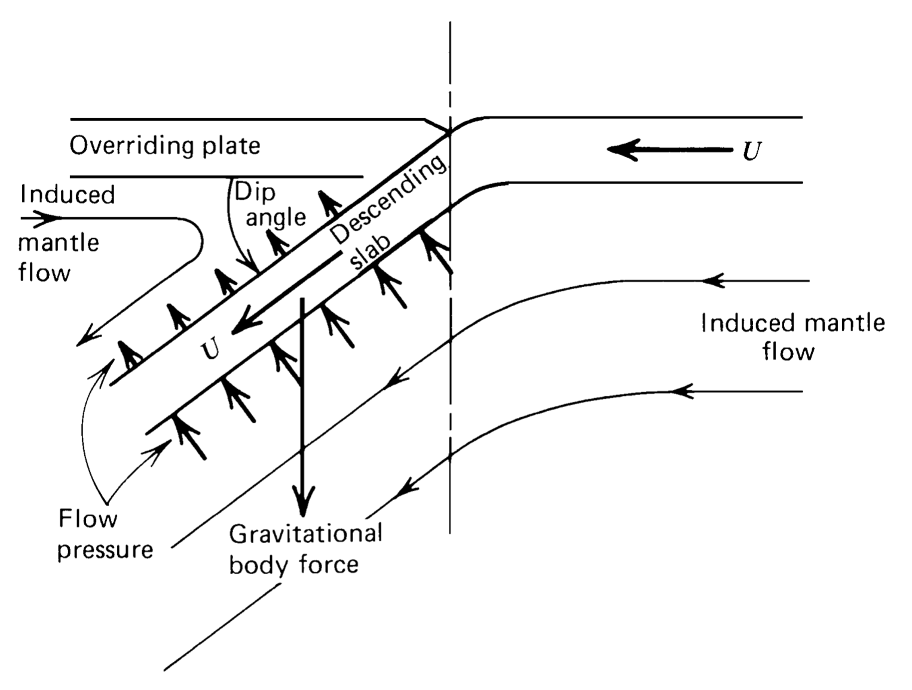
Idea: Pressure forces from corner flow balance slab weight
T&S: Fig. 6.17

Slide 10
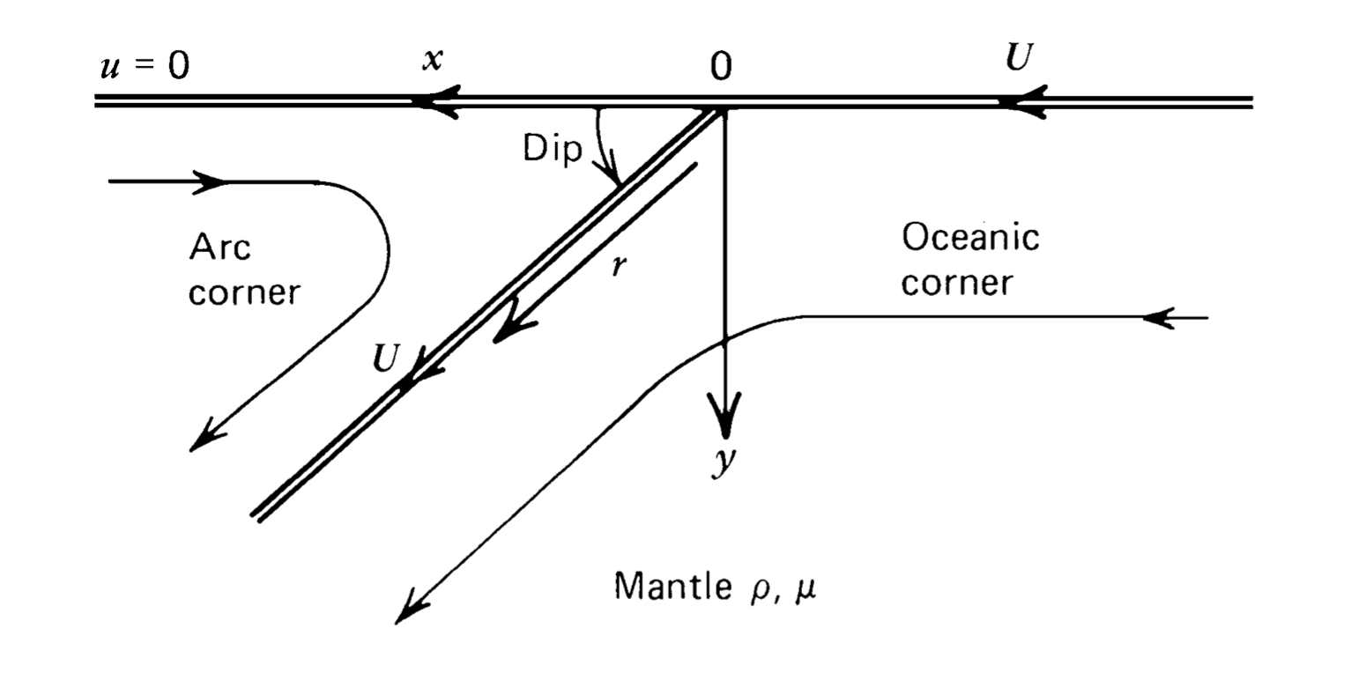
Idea: Pressure forces from corner flow balance slab weight
T&S: Fig. 6.17
T&S: Fig. 6.18
Corner flow model setup

Slide 11
Idea: Pressure forces from corner flow balance slab weight
T&S: Fig. 6.17
T&S: Fig. 6.18
Corner flow model setup
Appropriate for a stream function solution

Slide 12
Solution (see T&S Sect. 6.11)
Trench at x=0.
Surface (y=0, x<0) moves at constant speed U towards trench.
Surface (y=0, x>0) is stationary.
Slab velocity fixed at U and directed along the slab top (distance along slab top = r)

Slide 13
Solution (T&S Sect. 6.11)
Trench at x=0.
Surface (y=0, x<0) moves at constant speed U towards trench.
Surface (y=0, x>0) is stationary.
Slab velocity fixed at U and directed along the slab top (distance along slab top = r)
Two different flow fields (and stream functions): Arc corner and Oceanic corner

Slide 14
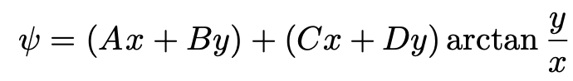
Solution (T&S Sect. 6.11)
Trench at x=0.
Surface (y=0, x<0) moves at constant speed U towards trench.
Surface (y=0, x>0) is stationary.
Slab velocity fixed at U and directed along the slab top (distance along slab top = r)
Two different flow fields (and stream functions): Arc corner and Oceanic corner
For the corner geometry, the relevant solution to biharmonic stream function equation is:

Slide 15
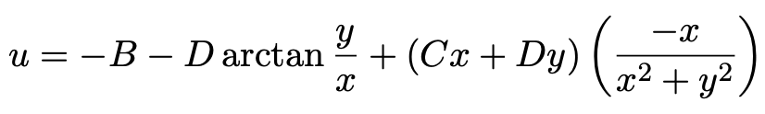
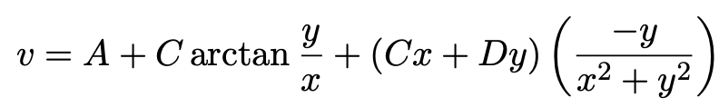
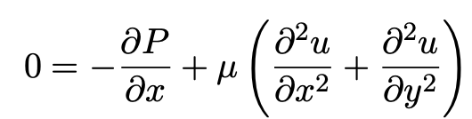
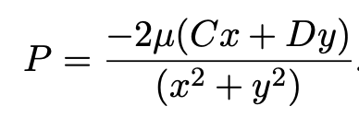
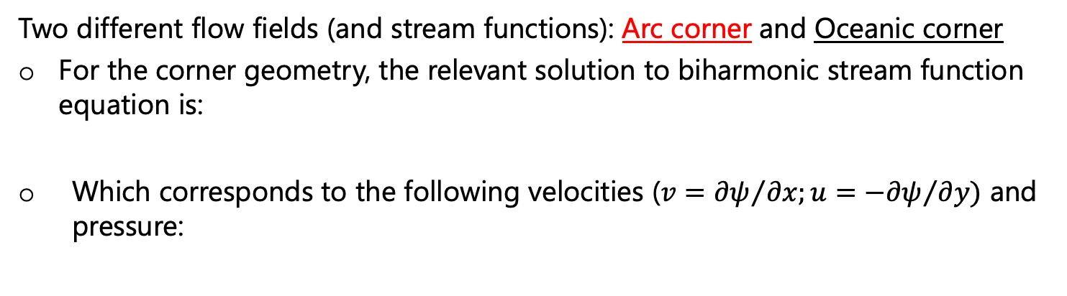
Solution (T&S Sect. 6.11)
Trench at x=0.
Surface (y=0, x<0) moves at constant speed U towards trench.
Surface (y=0, x>0) is stationary.
Slab velocity fixed at U and directed along the slab top (distance along slab top = r)
Two different flow fields (and stream functions): Arc corner and Oceanic corner
For the corner geometry, the relevant solution to biharmonic stream function equation is:
Which corresponds to the following velocities (${v=∂ψ}/{∂x;{u=−∂ψ}/{∂y})}$ and pressure:
Int.
(dynamic P)

Slide 16
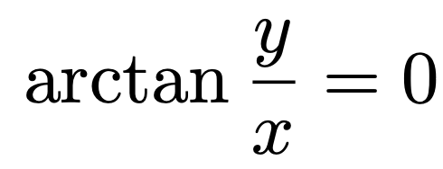
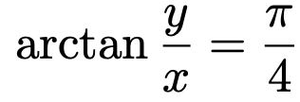
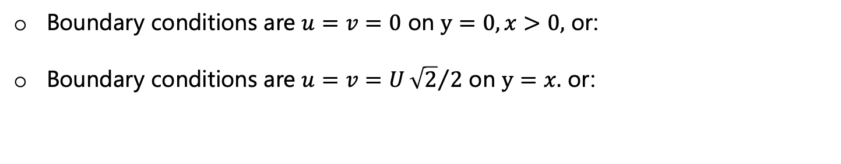
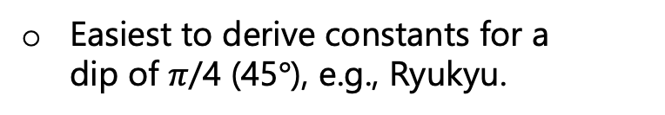
Solution (T&S Sect. 6.11)
Easiest to derive constants for a dip of $π$/4 (45$°$), e.g., Ryukyu.
Boundary conditions are $u=v=0$ on $y=0, x>0,$ or:
Boundary conditions are $u=v=U{\sqrt{2}}/2$ on $y=x.$ or:

Slide 17
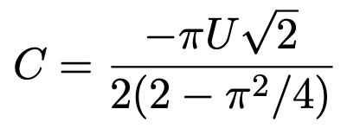
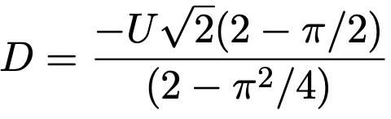
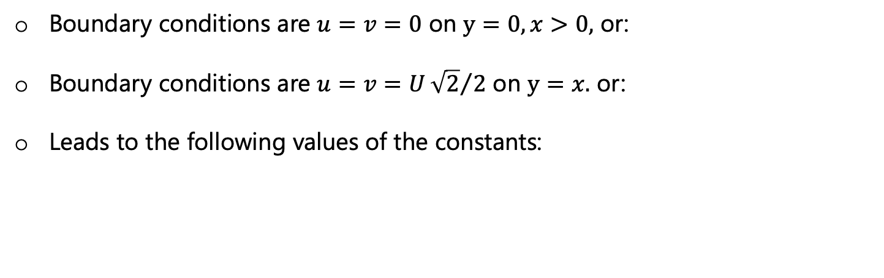
Solution (T&S Sect. 6.11)
Easiest to derive constants for a dip of $π$/4 (45$°$), e.g., Ryukyu.
Boundary conditions are $u=v=0$ on $y=0, x>0,$ or:
Boundary conditions are $u=v=U{\sqrt{2}}/2$ on $y=x.$ or:
Leads to the following values of the constants:

Slide 18
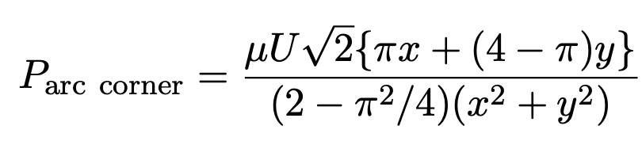
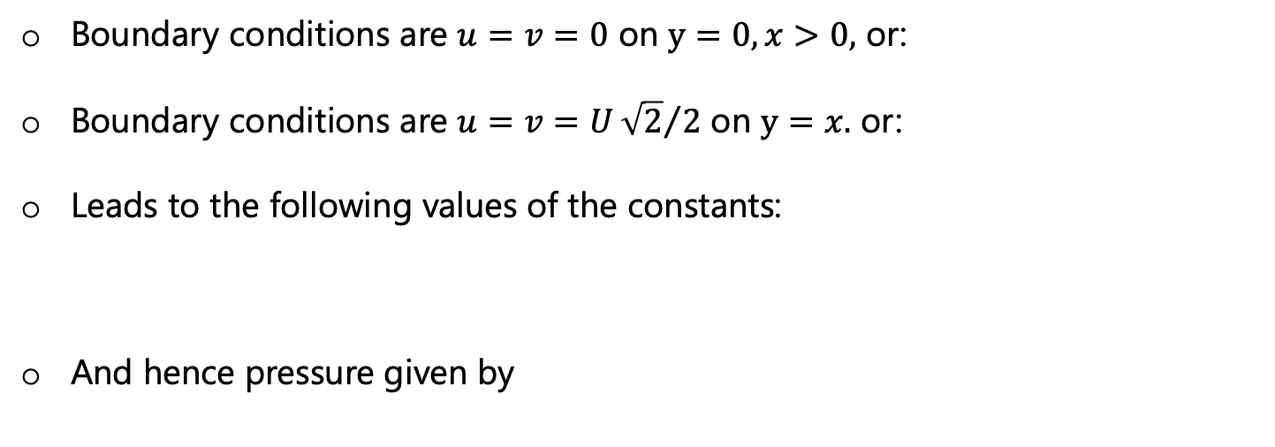
Solution (T&S Sect. 6.11)
Easiest to derive constants for a dip of $π$/4 (45$°$), e.g., Ryukyu.
Boundary conditions are $u=v=0$ on $y=0, x>0,$ or:
Boundary conditions are $u=v=U{\sqrt{2}}/2$ on $y=x.$ or:
Leads to the following values of the constants:
And hence pressure given by

Slide 19
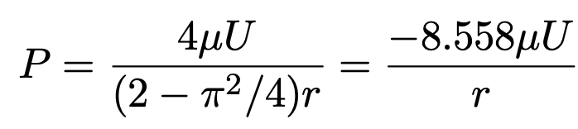
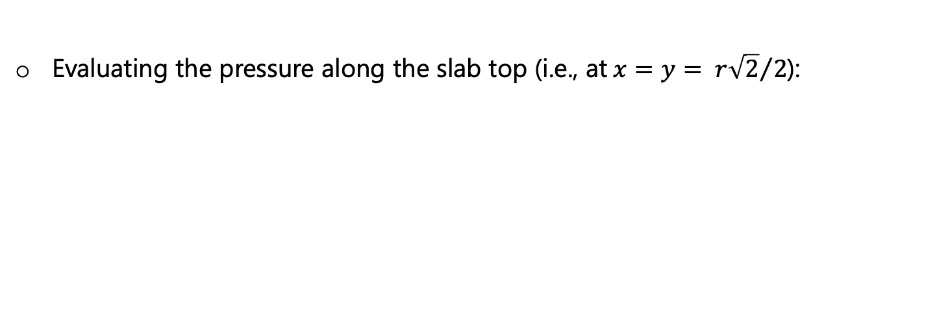
Solution (T&S Sect. 6.11)
Repeated from last slide:
Evaluating the pressure along the slab top (i.e., at$x=y= {r\sqrt{2}}/2$):

Slide 20
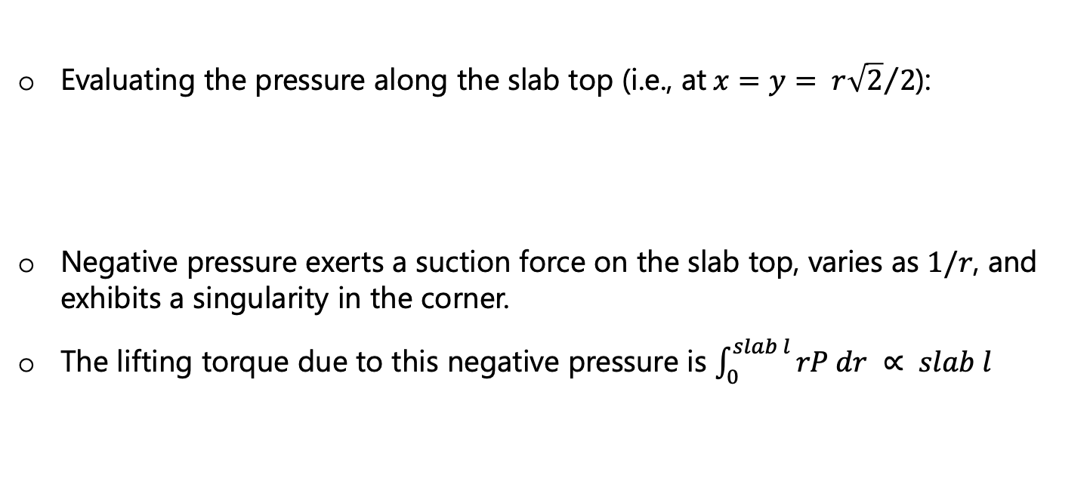
Solution (T&S Sect. 6.11)
Repeated from last slide:
Evaluating the pressure along the slab top (i.e., at$x=y= {r\sqrt{2}}/2$):
Negative pressure exerts a suction force on the slab top, varies as $1/r$, and exhibits a singularity in the corner.
The lifting torque due to this negative pressure is $\int_{0}^{slab l}{rP dr} ∝ slab l$

Slide 21
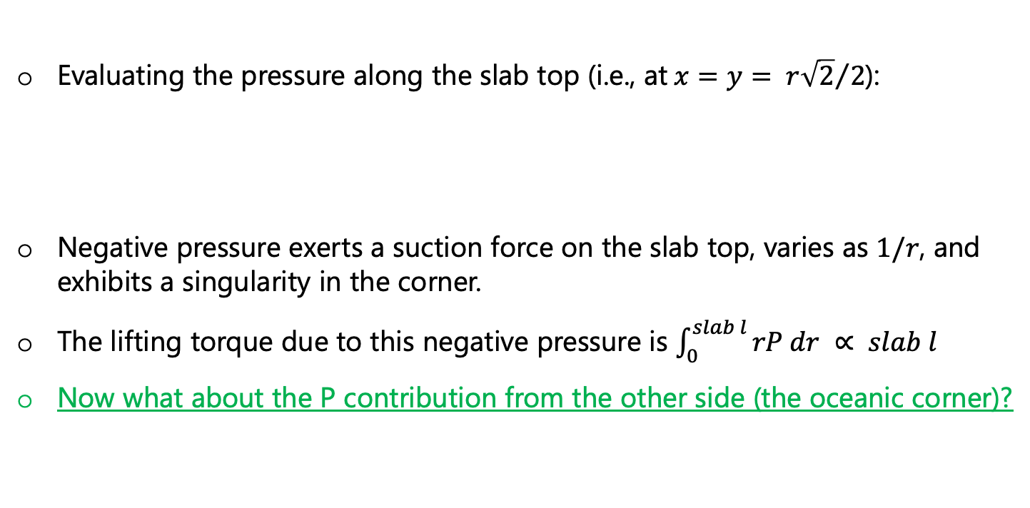
Solution (T&S Sect. 6.11)
Repeated from last slide:
Evaluating the pressure along the slab top (i.e., at$x=y= {r\sqrt{2}}/2$):
Negative pressure exerts a suction force on the slab top, varies as $1/r$, and exhibits a singularity in the corner.
The lifting torque due to this negative pressure is $\int_{0}^{slab l}{rP dr} ∝ slab l$
Now what about the P contribution from the other side (the oceanic corner)?

Slide 22
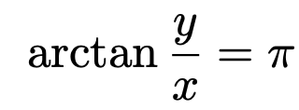
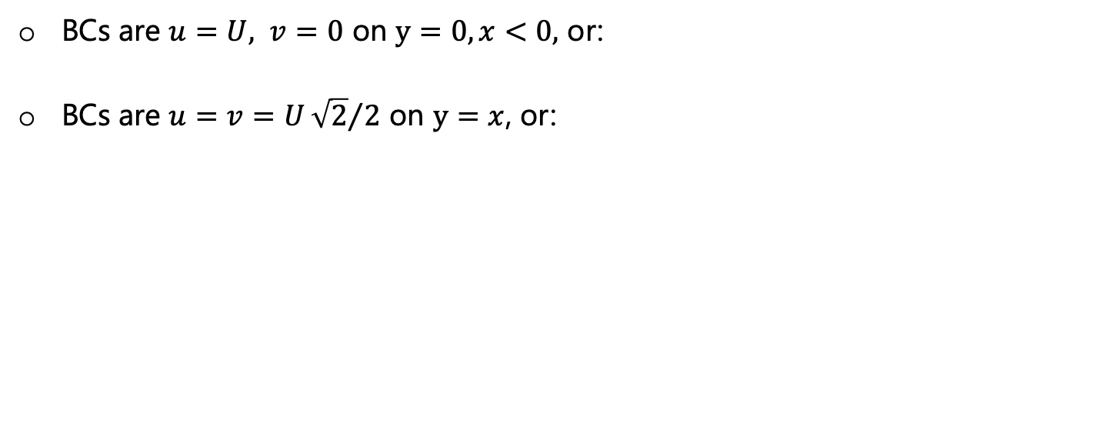
Solution (T&S Sect. 6.11)
The oceanic corner
BCs are $u=U, v=0$ on $y=0, x<0,$ or:
BCs are $u=v=U{\sqrt{2}}/2$ on $y=x$, or:

Slide 23
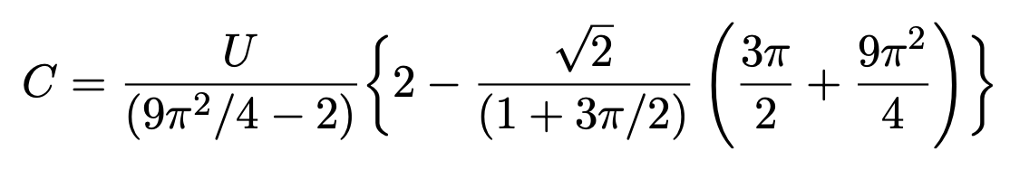
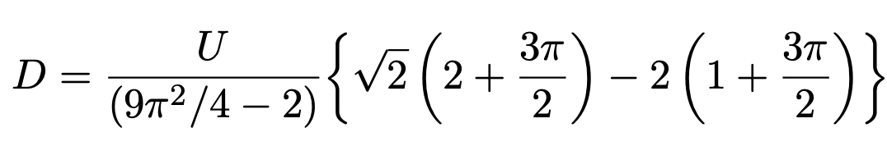
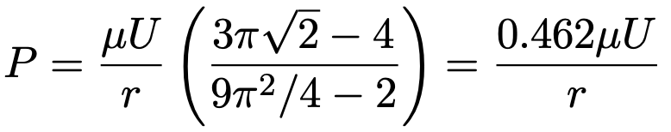
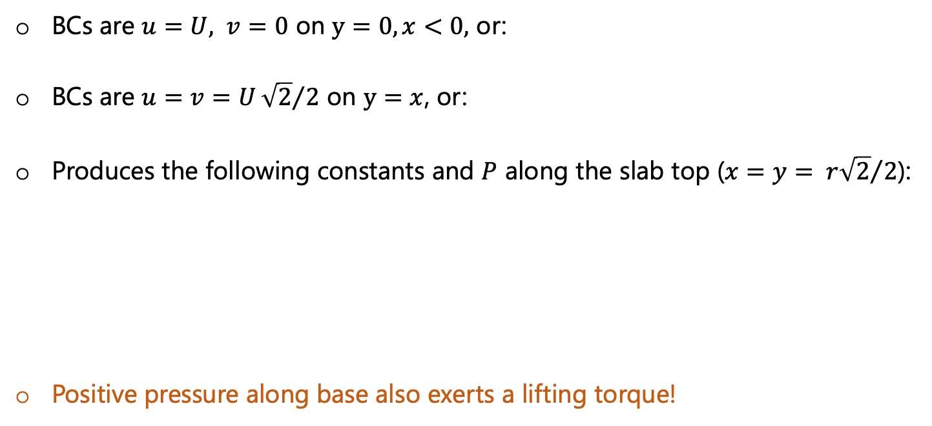
Solution (T&S Sect. 6.11)
The oceanic corner
BCs are $u=U, v=0$ on $y=0, x<0,$ or:
BCs are $u=v=U{\sqrt{2}}/2$ on $y=x$, or:
Produces the following constants and $P$ along the slab top ($x=y= {r\sqrt{2}}/2$):
Positive pressure along base also exerts a lifting torque!

Slide 24
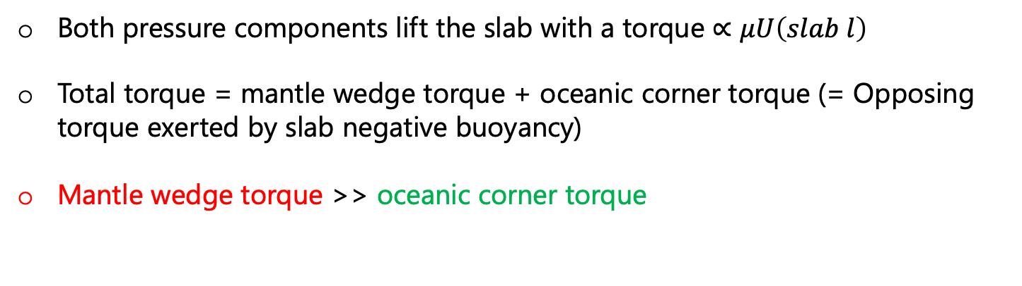
Pressure force from above and below
Both pressure components lift the slab with a torque $∝μU\left(slab l\right)$
Total torque = mantle wedge torque + oceanic corner torque (= Opposing torque exerted by slab negative buoyancy)
Mantle wedge torque >> oceanic corner torque

Slide 25
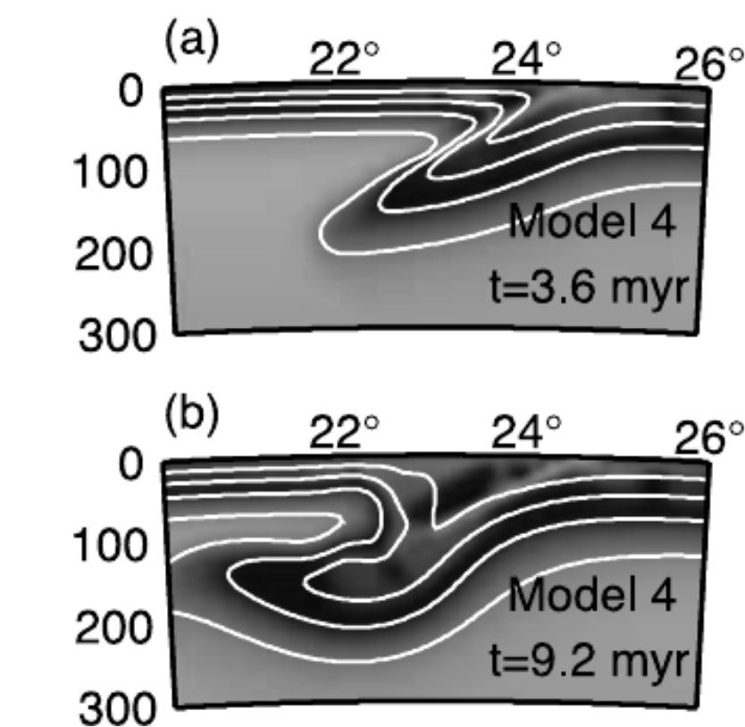
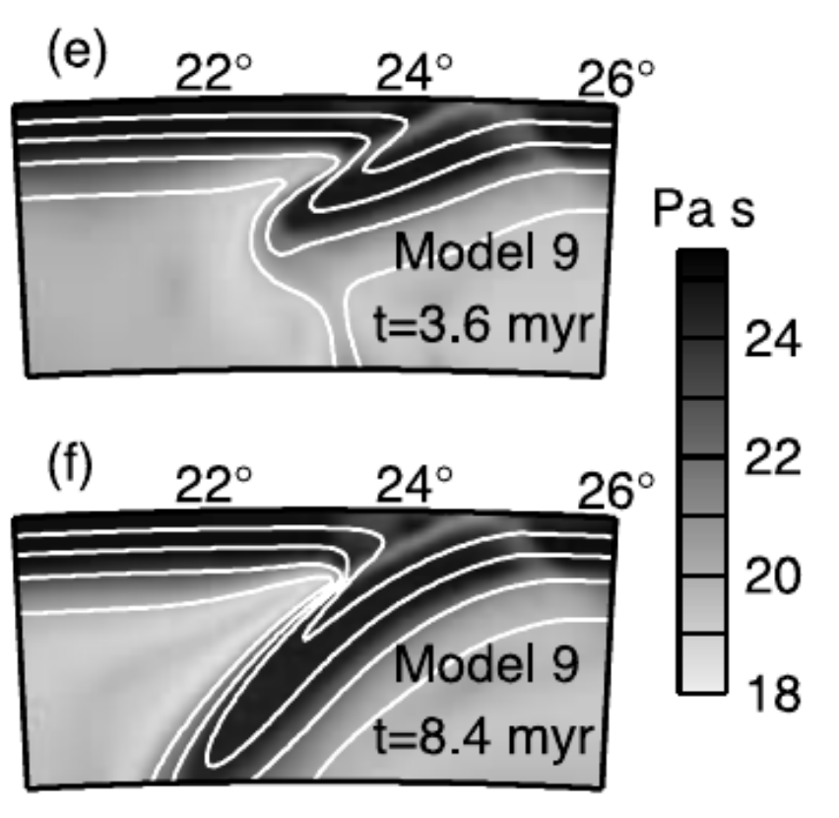
Other applications
Lower mantle wedge viscosity (e.g., due to power-law flow - Model 9) produces lower suction force and so higher dip (Billen and Hirth, 2005, GRL)

Slide 26
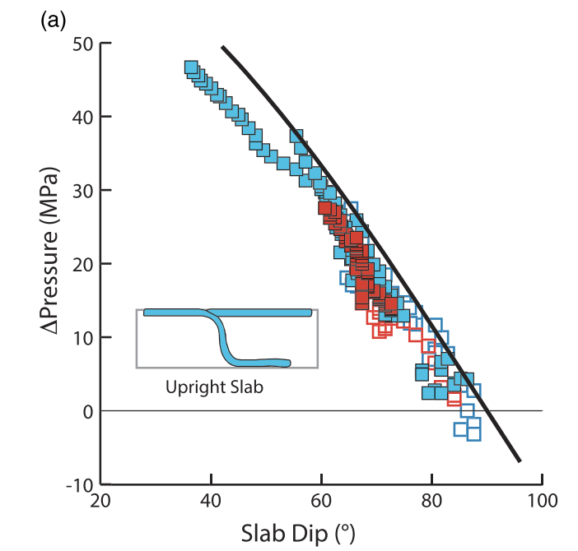
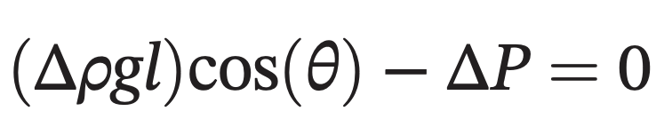
Other applications
Lower mantle wedge viscosity (e.g., due to power-law flow - Model 9) produces lower suction force and so higher dip (Billen and Hirth, 2005, GRL)
Can we use slab dip to probe pressure in the mantle? (Royden and Holt, 2020, G-cubed)

Slide 27
Switching gears: The main forces acting on subducting plates

Slide 28
Switching gears: The main forces acting on subducting plates
”Ridge push” vs. “Slab pull”
What is the primary driver of plate motions?
Notes:
https://www3.nd.edu/~cneal/PlanetEarth/Chapt-11a-Rock-Mechanics.pdf

Slide 29
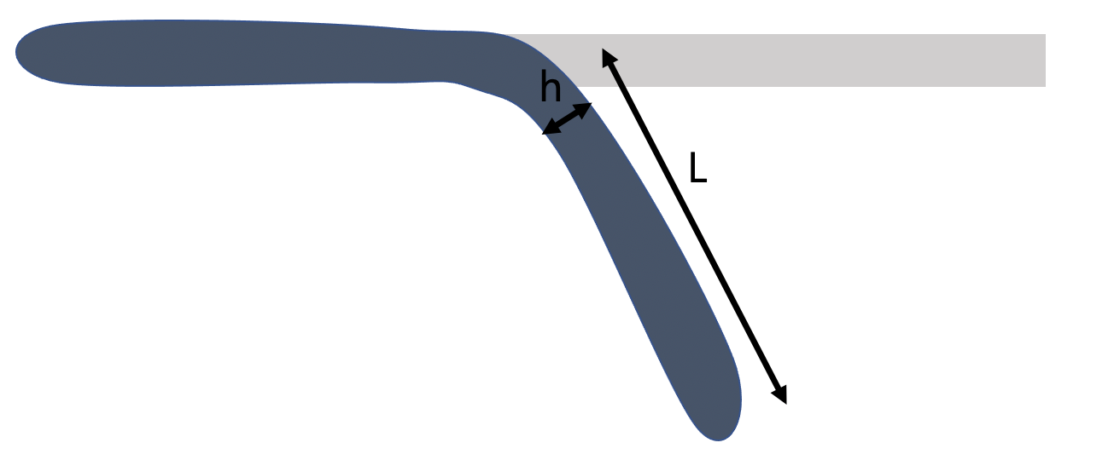
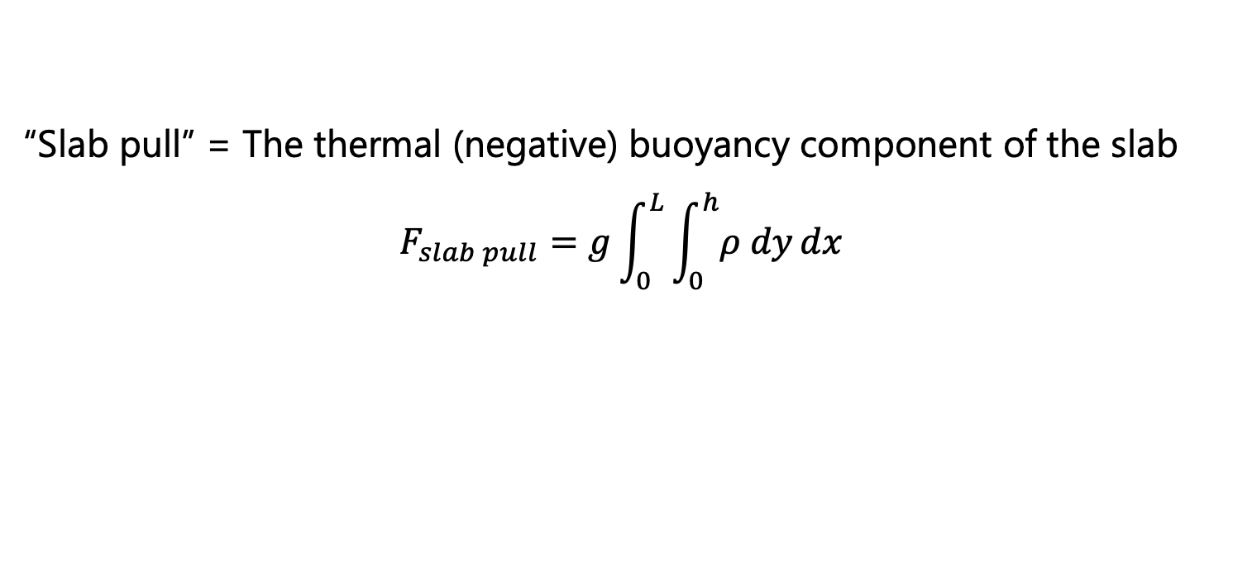
Switching gears: The main forces acting on subducting plates
“Slab pull” = The thermal (negative) buoyancy component of the slab
$$F_{slab pull}=g\int_{0}^{L}{\int_{0}^{h}{ρ dy}dx}$$
$$ρ_{0}T_{0}$$

Slide 30
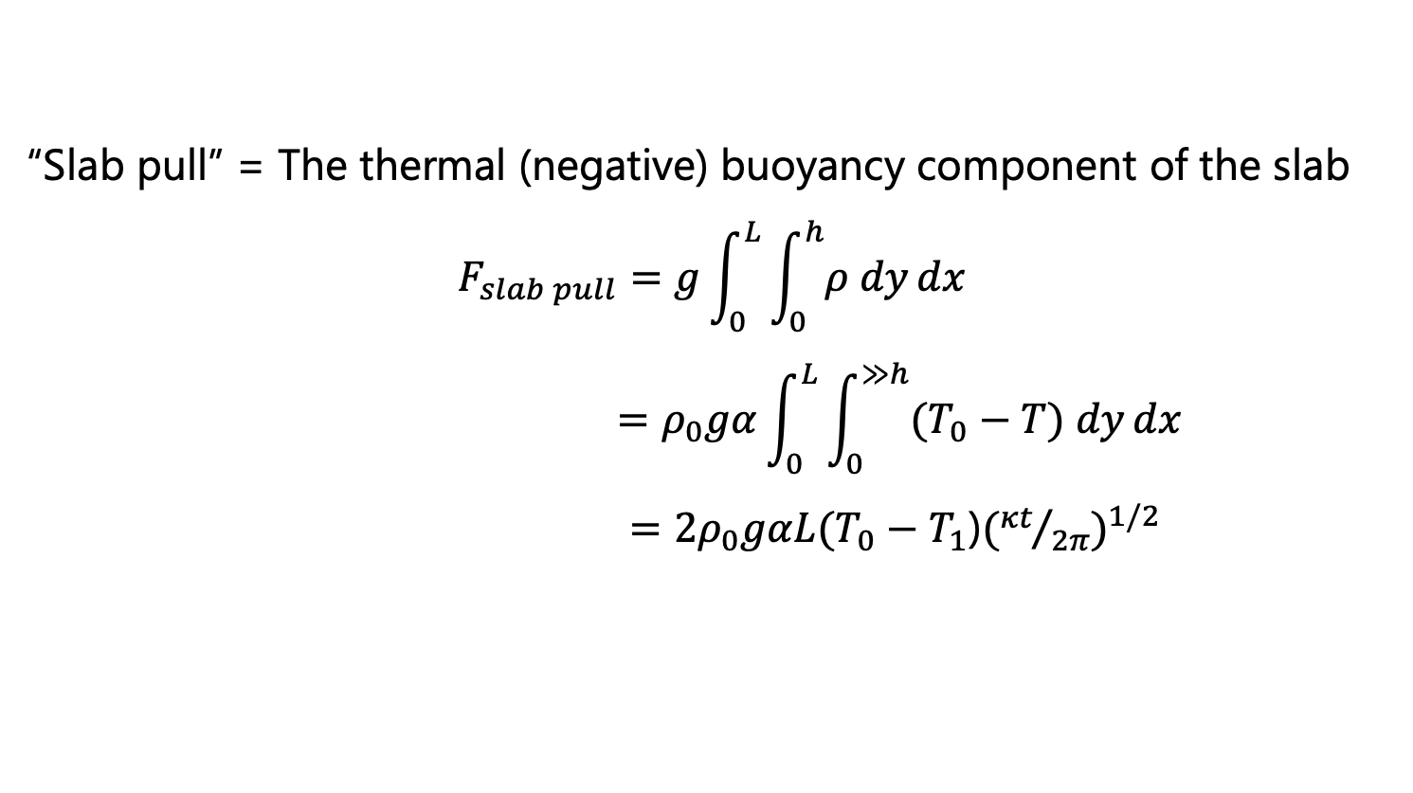
Switching gears: The main forces acting on subducting plates
“Slab pull” = The thermal (negative) buoyancy component of the slab
$$F_{slab pull}=g\int_{0}^{L}{\int_{0}^{h}{ρ dy}dx}$$
$$=ρ_{0}gα\int_{0}^{L}{\int_{0}^{≫h}{(T_{0}−T) dy}dx}$$
$=2ρ_{0}gαL(T_{0}−T_{1}$)$({{κt}/{2π})}^{1/2}$
$$ρ_{0}T_{0}$$

Slide 31
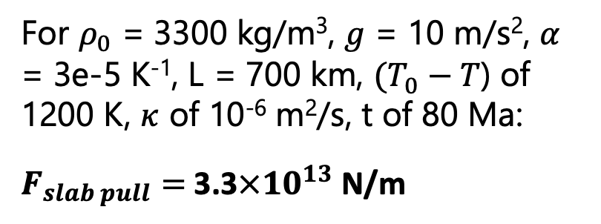
Switching gears: The main forces acting on subducting plates
“Slab pull” = The thermal (negative) buoyancy component of the slab
$$F_{slab pull}=g\int_{0}^{L}{\int_{0}^{h}{ρ dy}dx}$$
$$=ρ_{0}gα\int_{0}^{L}{\int_{0}^{≫h}{(T_{0}−T) dy}dx}$$
$=2ρ_{0}gαL(T_{0}−T_{1}$)$({{κt}/{2π})}^{1/2}$
$$ρ_{0}T_{0}$$
For $ρ_{0}$ = 3300 kg/m³, $g$ = 10 m/s², $α$ = 3e-5 K⁻¹, L = 700 km, $(T_{0}−T$) of 1200 K, $κ$ of 10⁻⁶ m²/s, t of 80 Ma:
$F_{slab pull}=$ 3.3$×{10}^{13}$ N/m
Notes:
https://www3.nd.edu/~cneal/PlanetEarth/Chapt-11a-Rock-Mechanics.pdf

Slide 32
The main forces acting on subducting plates
“Ridge push” = The pressure head (due to ridge elevation) that drives the flow horizontally away from the ridges. Can also be thought of as gravitational sliding.

Slide 33

The main forces acting on subducting plates
“Ridge push” = The pressure head (due to ridge elevation) that drives the flow horizontally away from the ridges. Can also be thought of as gravitational sliding.
Becker and Faccenna
Notes:
https://www3.nd.edu/~cneal/PlanetEarth/Chapt-11a-Rock-Mechanics.pdf

Slide 34
The main forces acting on subducting plates
“Ridge push” = The pressure head (due to ridge elevation) that drives the flow horizontally away from the ridges. Can also be thought of as gravitational sliding.
p₁ > p₂, which produces a pressure “push” force to the right
Becker and Faccenna
Notes:
https://www3.nd.edu/~cneal/PlanetEarth/Chapt-11a-Rock-Mechanics.pdf

Slide 35


The main forces acting on subducting plates
“Ridge push” = The pressure head (due to ridge elevation) that drives the flow horizontally away from the ridges. Can also be thought of as gravitational sliding.

Slide 36

The main forces acting on subducting plates
“Ridge push” = The pressure head (due to ridge elevation) that drives the flow horizontally away from the ridges. Can also be thought of as gravitational sliding.

Slide 37
The main forces acting on subducting plates
“Ridge push” = The pressure head (due to ridge elevation) that drives the flow horizontally away from the ridges. Can also be thought of as gravitational sliding.
$F_{R}≈$ 3.3$×{10}^{12}$ N/m (~an order of magnitude less than slab pull)

Slide 38



Slide 39
Reminder: Slab pull and ridge push not the only important forces
Mantle drag and pressure also!

Slide 40
Reminder: Slab pull and ridge push not the only important forces
And slab bending!
Mantle drag and pressure also!

Slide 41

Take homes:
Subduction zone “corner flow” solution another classic application of the stream function.
Negative pressure in mantle wedge corner, positive pressure beneath the slab combine to exert lift on the slab ($∝μU slab l)$.
Probably the most important forces on subducting plates: slab pull (SP) and ridge push (RP). SP thought to be >> RP
Other important force relate to: mantle drag, plate bending, slab suction (i.e., as above), buoyancy due mantle phase transitions, plate interface coupling.

